Slide 1

How gaming has changed
in the last 20 years
A short presentation by James Tyler, Matthew Lyle and Marta Grazia

Slide 2


Videogames have changed
…a lot

Slide 3
Splitscreen vs Online Multiplayer
Rise of the Indie Games
Everything’s going Virtual!
What changed

Slide 4
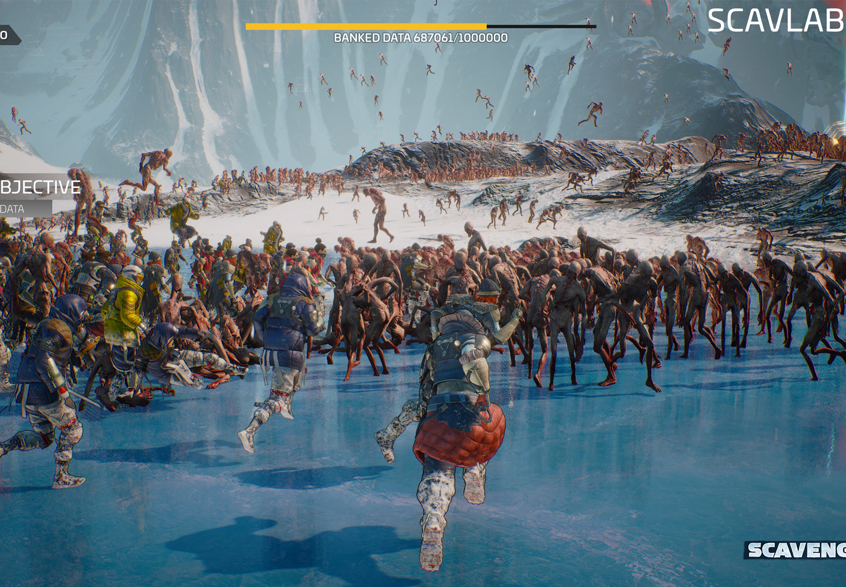
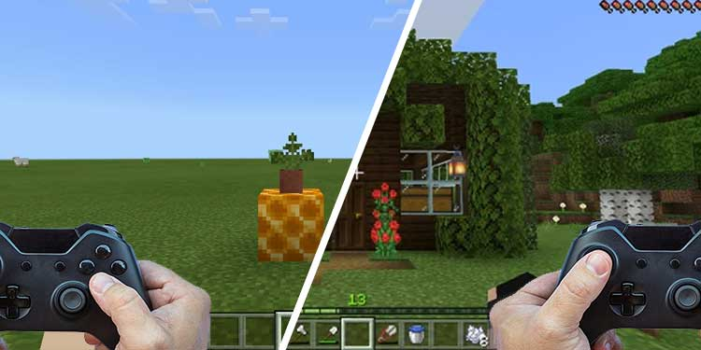
Split screen
VS
Online Multiplayer

Slide 5
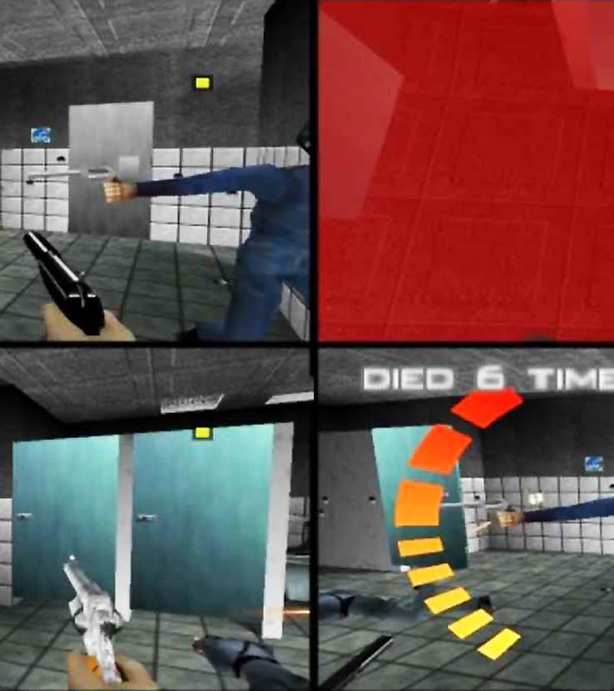
Allows up to 4 players to play together in non-networked videogames
Divides the screen in equal areas. Allows players to move freely from each other
It became really popular on consoles up until the 2000
What is Splitscreen

Slide 6
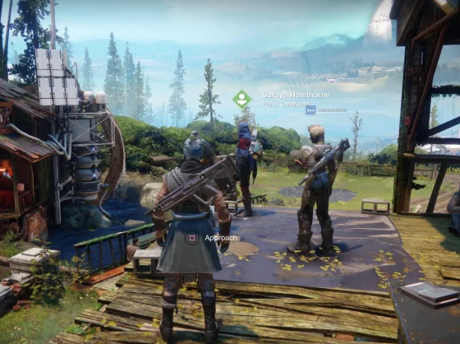
It allows players to play in the same game environment connecting them over a wide area network
It allows players to interact from all over the world
It requires active game servers to host sessions and transmit game data to and from clients.
What is Online Multiplayer

Slide 7
Split Screen
You play from the same room
One copy of the game will suffice!
You’ll have to squint loads!
Can’t play with my brother in Italy ☹
As long as the system works it will work
You play from your own system
Everyone has to buy their copy
The screen is all mine!
I can play with anyone in the world! ☺
If the game servers shut it won’t work
Online Multiplayer

Slide 8
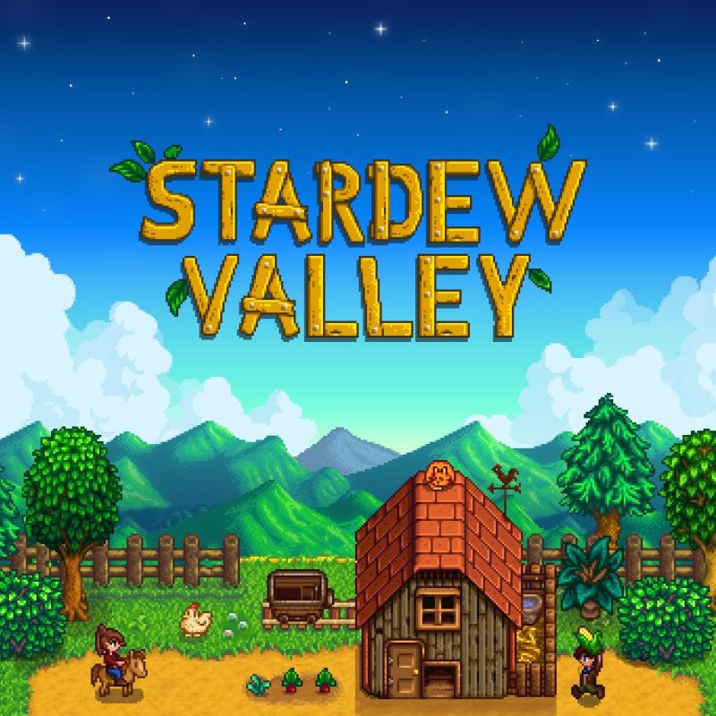
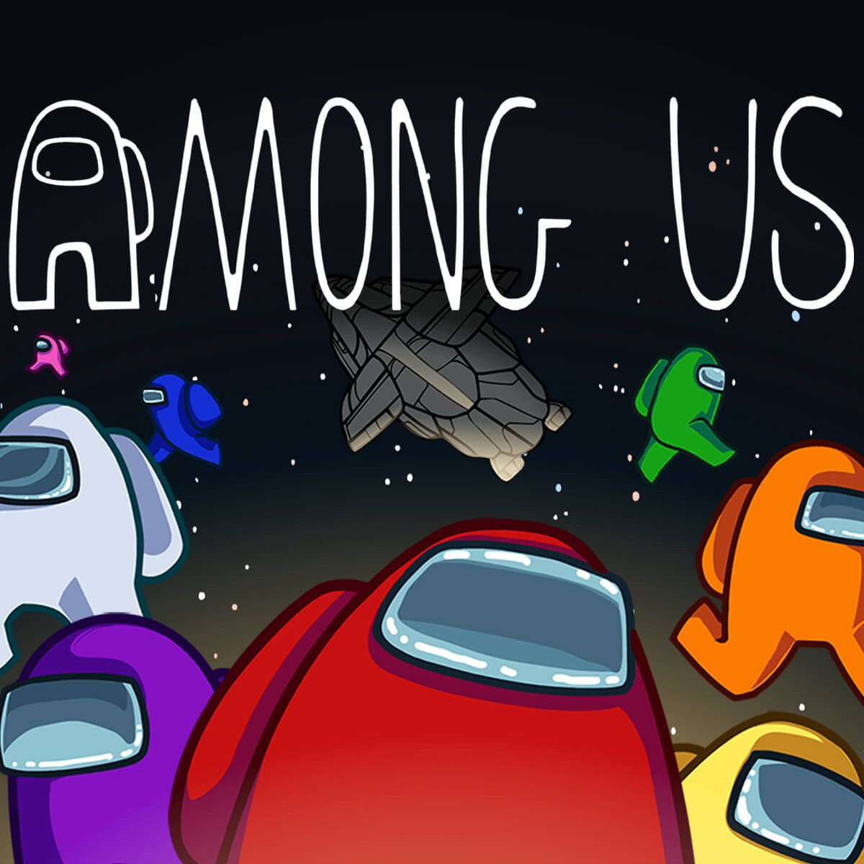



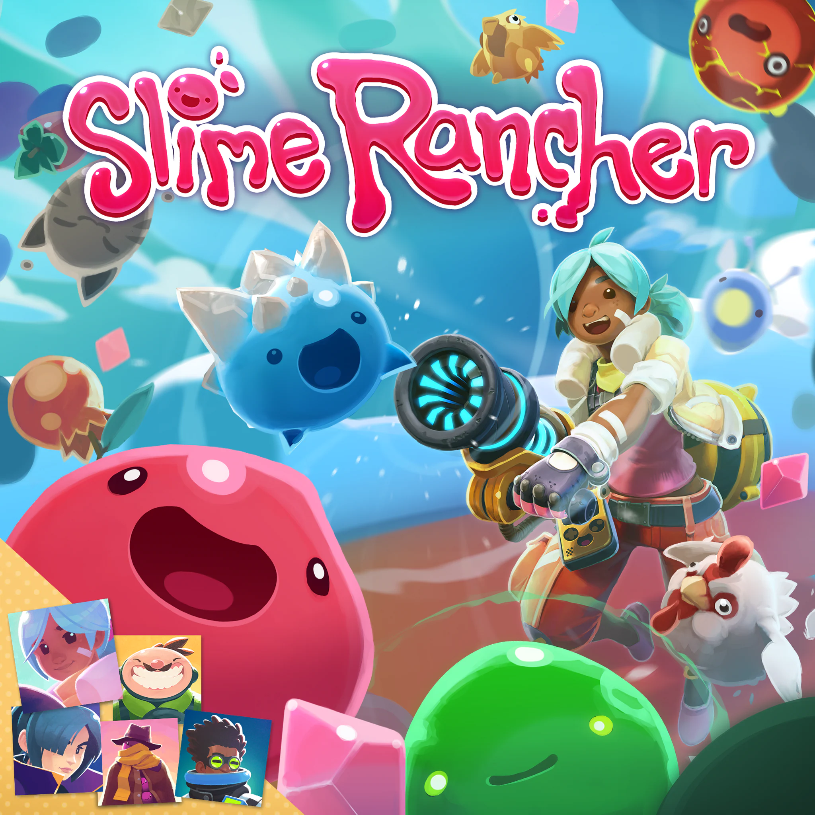
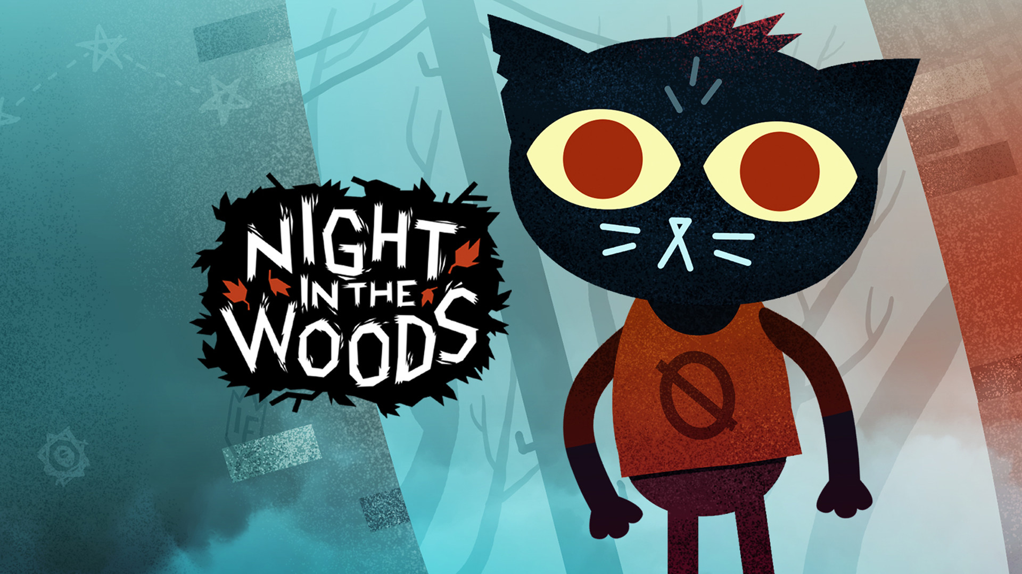
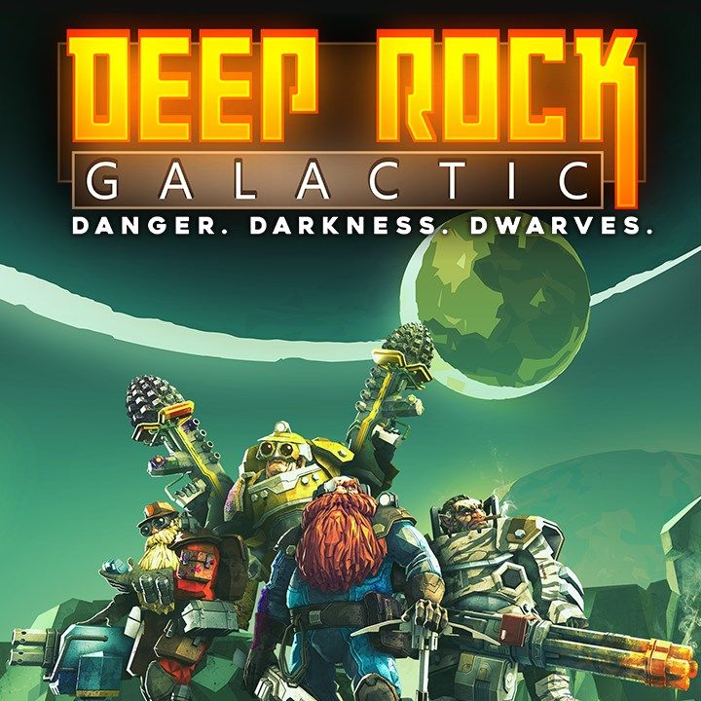


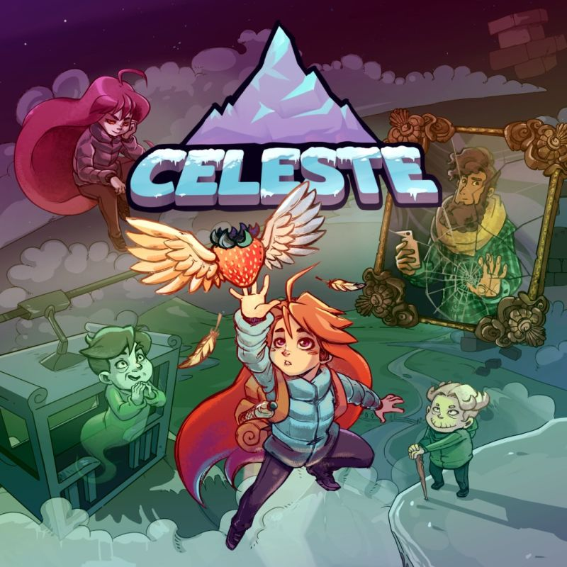

Rise of the Indie Games

Slide 9
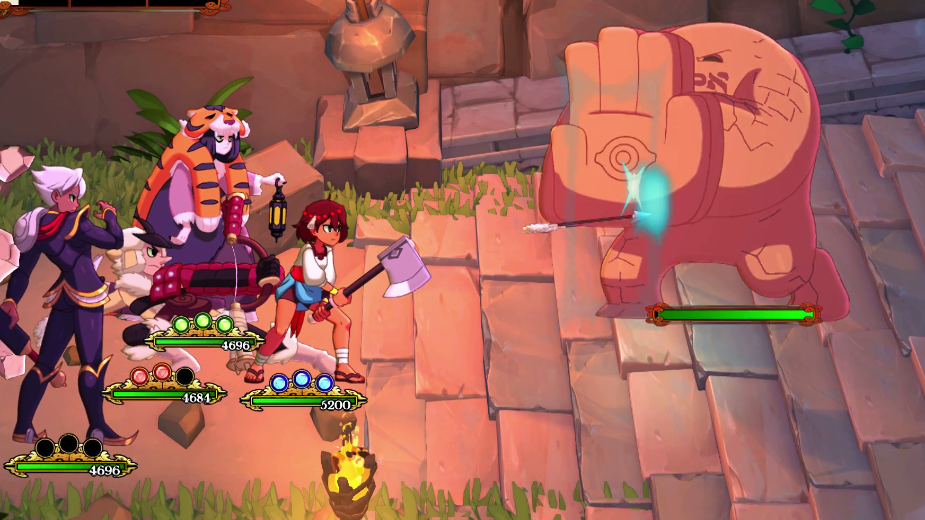
What is an Indie Game?
An Indie game is a game developed by an independent game development team consisting of a small number of people.
Traditionally, most games were only made by renowned game studios. These games were financially backed from big games and publishing companies.
Indie game developers fund their games entirely out of pocket.
These games have become very popular over the years, granting the freedom and flexibility for people to make and publish their own games.
Indie games were around in the early 2000s, albeit rare. They gained traction a lot more during 2010s and continuing to grow to this day!

Slide 10


Main differences
Indie Games
Triple A Games
Solo or small teams
Low Budget
More creative control
Tend to be lesser known
Smaller, closely-knit communities
Most are only available on PC
Cheaper (£10+)
Large teams
High Budget
More controlled – revisions made often
Well known – highly marketed
Larger and expanding communities
Are usually found on PC and/or Consoles
More expensive (£50+)

Slide 11

List of Indie Games
Among Us
Stardew Valley
Cult of the Lamb
Five Nights at Freddy’s
Crypt of The Necrodancer
Cuphead
Baldi’s Basics in Education & Learning
Don’t Starve
Subnautica
Kerbal Space Program
Hollow Knight
Night in The Woods
Undertale
The Binding of Isaac
Hotline Miami
Superhot
Friday Night Funkin’
Fall Guys
Outlast
Hades
Risk of Rain
Deep Rock Galactic
Deltarune
Faster Than Light
Helltaker
Getting Over It with Bennett Foddy
Enter The Gungeon
Celeste
A Hat In Time
Hylics
Little Nightmares
Indivisible
Inscryption
Iron Lung
Journey
Jump King
LISA: The Painful
Metal: Hellsinger
Minecraft
Neon White
No Man’s Sky
Omori
Outer Wilds
Ori & The Blind Forest
Phasmophobia
Rivals of Aether
Rogue Legacy
Sable
Scorn
SCP – Containment Breach
Shantae
Shovel Knight
Sifu
Skullgirls
Slime Rancher
Soma
Spelunky
Stray
Transistor
Untitled Goose Game
VA-11 Hall-A
Vampire Survivors
Viscera Cleanup Duty
VRChat
World of Horror
Yume Nikki
+ 1000s more

Slide 12

Everything’s going Virtual!

Slide 13
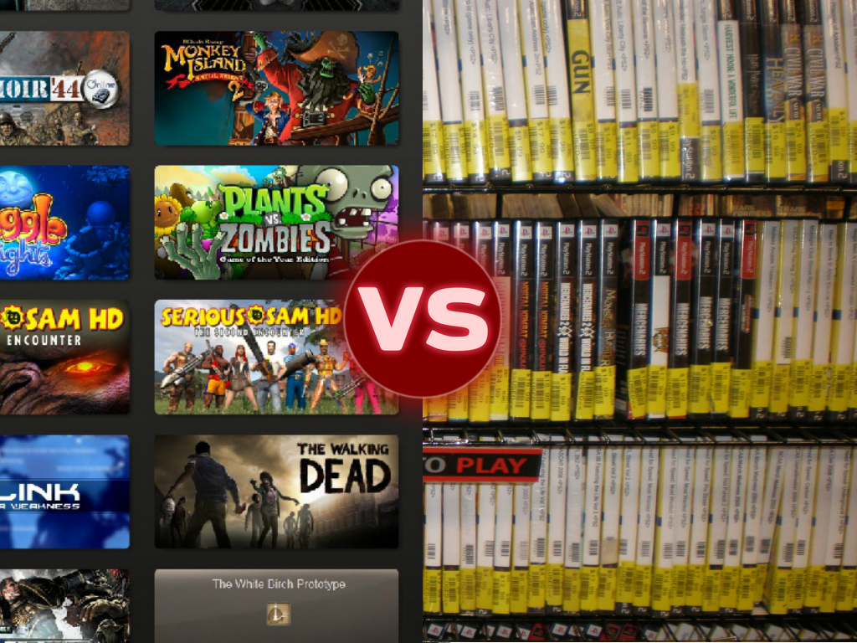
Games were originally sold as physical disc in a case.
These cases would include the disc, and often an extensive manual to help players understand the game.
Nowadays, everything is conveniently downloaded through the internet and installed completely digitally. No more queuing for the midnight release at the local GAME store!
However, many people to this day still get physical copies of games such as collectible hobbyists.
Physical vs Digital

Slide 14
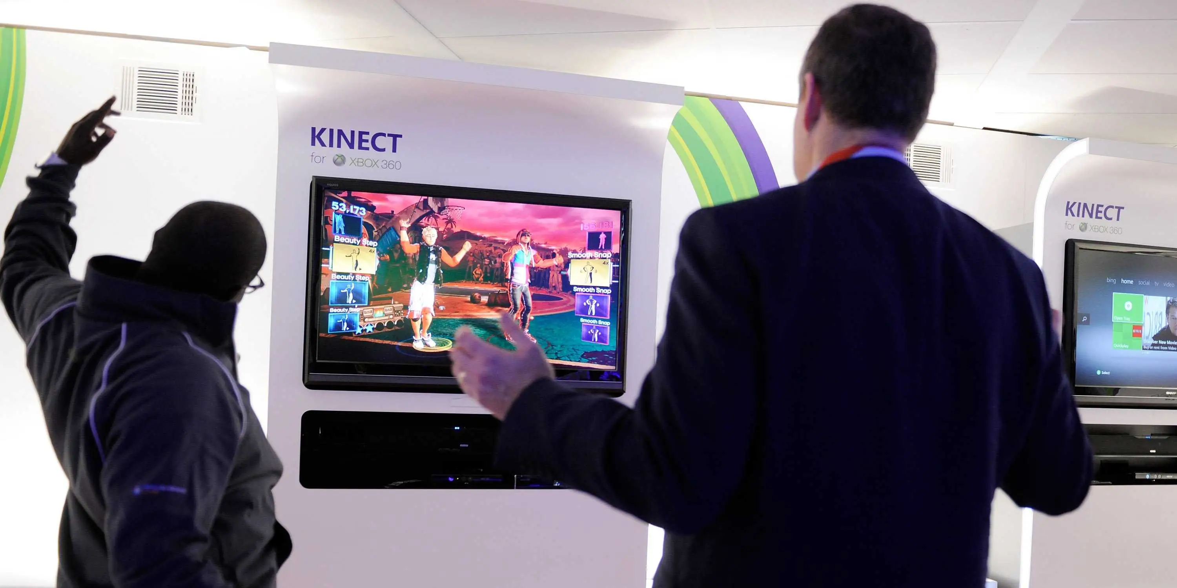

Physical Interaction with Games
During the mid 2000s, games had branched off into using your own body and actions to manipulate the game world! With the use of a camera tracking and at least one person, there could be countless hours of fun!
In Winter of 2006, the Nintendo Wii released changing the scope of how games were played. Many big companies followed suit after realizing the high demand for this new medium of gaming.
Games of this nature involved simulations of various activities, mostly including things like sports, but also party games for social gatherings.
Whilst very engaging, it also promoted exercise. When games were traditionally just sitting in front of a screen, now people could move to play their games.

Slide 15

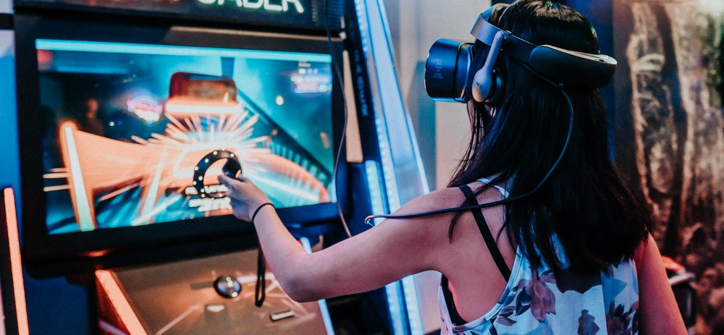
The Next Step -Virtual Reality! 😲
Virtual Reality is a simulated experience that completely immerses the user in a virtual environment, with them being able to manipulate the world around them.
In 2012, a kickstart campaign for the Oculus Rift headset was announced. The project got $2.4 million dollars from backers.
Nowadays, more and more games developers are making VR games, or updating current games to have VR capability!
Despite being extremely engaging, VR isn’t cheap. Due to this, the market for VR is only growing gradually.

Slide 16
Thank You for listening
Any Questions?

